Slide 1
Rest API Best Practices

Slide 2
What is a REST API?
A REST API is an application programming interface that conforms to specific architectural constraints, like stateless communication and cacheable data.
It is not a protocol or standard. While REST APIs can be accessed through a number of communication protocols, most commonly, they are called over HTTPS, so the guidelines below apply to REST API endpoints that will be called over the internet.
Best practices for REST API authentication :
https://stackoverflow.blog/2021/10/06/best-practices-for-authentication-and-authorization-for-rest-apis/

Slide 3
Accept and respond with JSON
REST APIs should accept JSON for request payload and also send responses to JSON. JSON is the standard for transferring data. Almost every networked technology can use it.
Form data is good for sending data, especially if we want to send files. But for text and numbers, we don’t need form data to transfer those since—with most frameworks—we can transfer JSON by just getting the data from it directly on the client side.
we should set Content-Type in the response header to application/json after the request is made. Some HTTP clients look at the Content-Type response header and parse the data according to that format.
if we’re trying to send and receive files between client and server. Then we need to handle file responses and send form data from client to server.

Slide 4
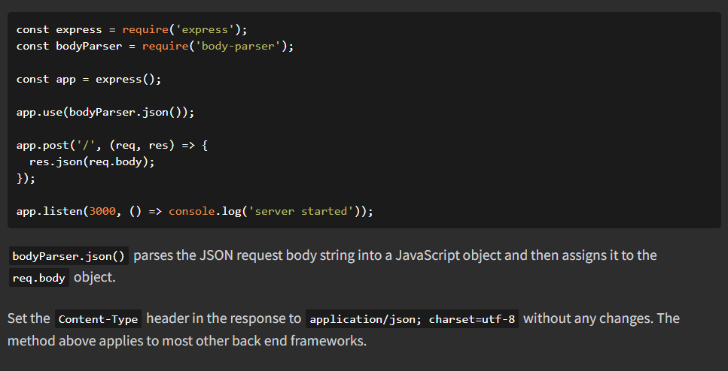

Slide 5
The action should be indicated by the HTTP request method that we’re making. The most common methods include GET, POST, PUT, and DELETE.
GET retrieves resources.(সম্পদ উদ্ধার করে)
POST submits new data to the server.
PUT updates existing data.
DELETE removes data.
The verbs map to CRUD operations.
We should create routes like GET /articles/ for getting news articles. Likewise, POST /articles/ is for adding a new article , PUT /articles/:id is for updating the article with the given id. DELETE /articles/:id is for deleting an existing article with the given ID.

Slide 6
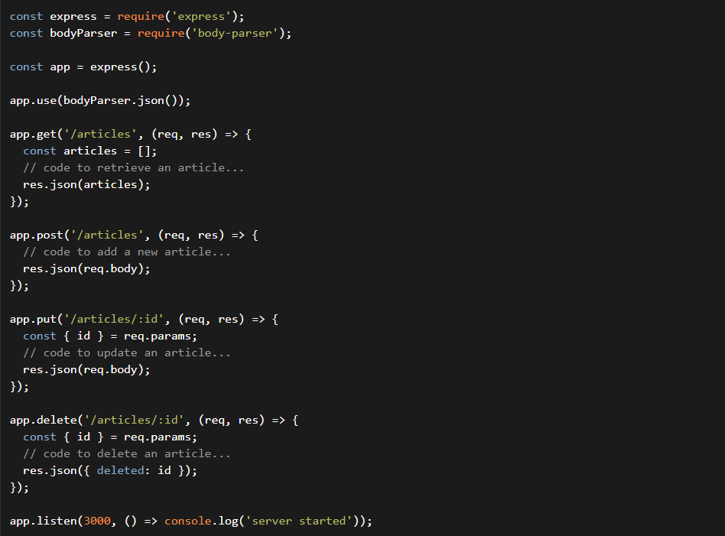

Slide 7
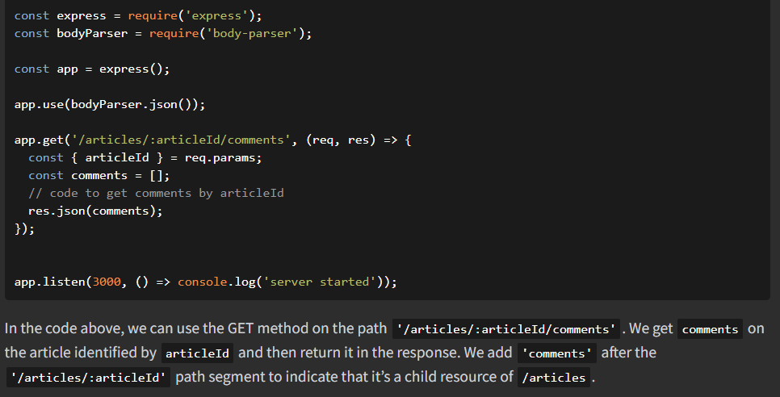
If we want an endpoint to get the comments for a news article, we should append the /comments path to the end of the /articles path.

Slide 8
Suppose you wanted to return the author of particular comments. You could use
/articles/:articleId/comments/:commentId/author .
But that’s getting out of hand. Instead, return the URI for that particular user within the JSON response instead:
"author": "/users/:userId"

Slide 9
Handle errors gracefully and return standard error codes
Common error HTTP status codes include:
400 Bad Request – This means that client-side input fails validation.
401 Unauthorized – This means the user isn’t not authorized to access a resource. It usually returns when the user isn’t authenticated.
403 Forbidden – This means the user is authenticated, but it’s not allowed to access a resource.
404 Not Found – This indicates that a resource is not found.
500 Internal server error – This is a generic server error. It probably shouldn’t be thrown explicitly.
502 Bad Gateway – This indicates an invalid response from an upstream server.
503 Service Unavailable – This indicates that something unexpected happened on server side (It can be anything like server overload, some parts of the system failed, etc.).

Slide 10
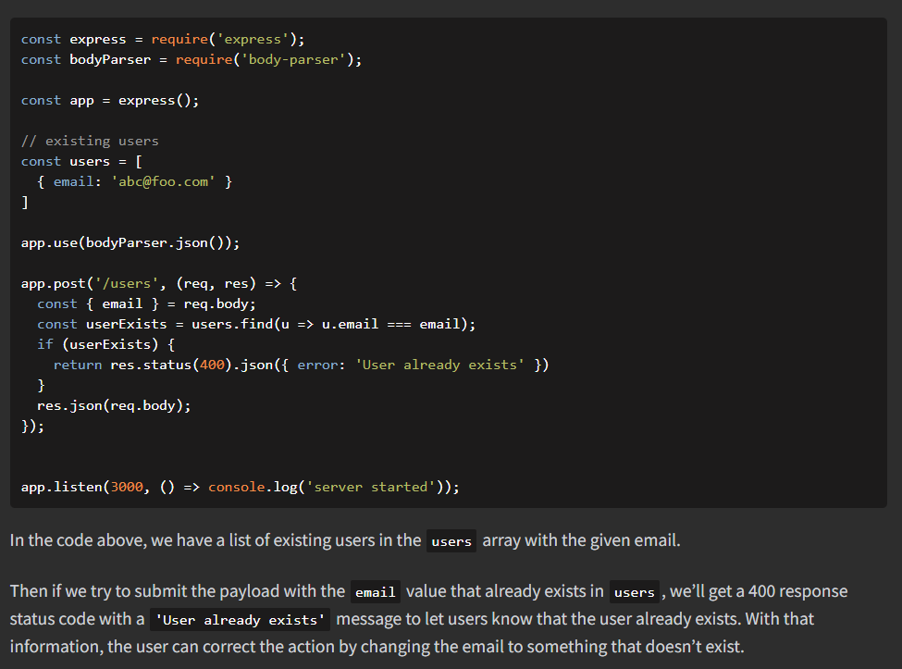
If we want to reject the data from the request payload, then we should return a 400 response as follows in an Express API:

Slide 11
Allow filtering, sorting, and pagination(পৃষ্ঠা সংখ্যা)
The databases behind a REST API can get very large. Sometimes, there’s so much data that it shouldn’t be returned all at once because it’s way too slow or will bring down our systems. Therefore, we need ways to filter items.

Slide 12
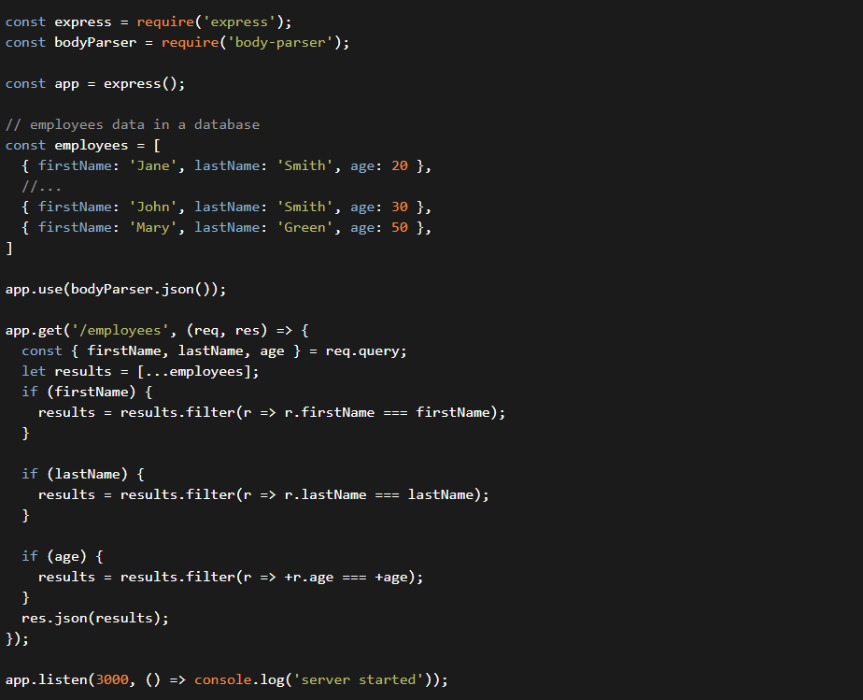

Slide 13

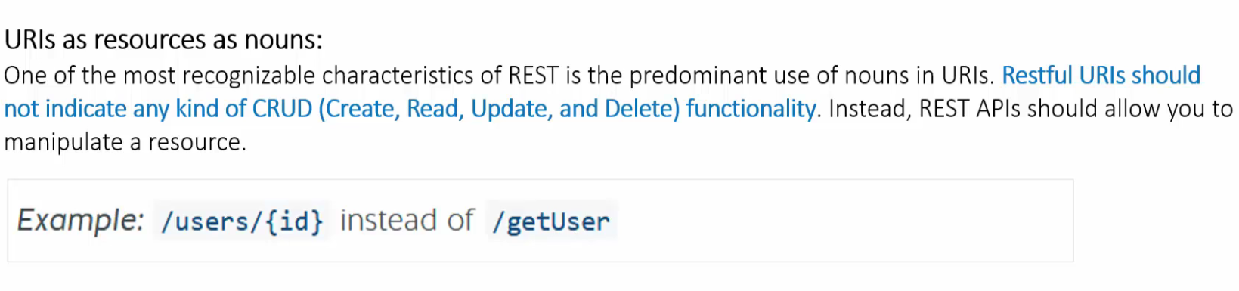
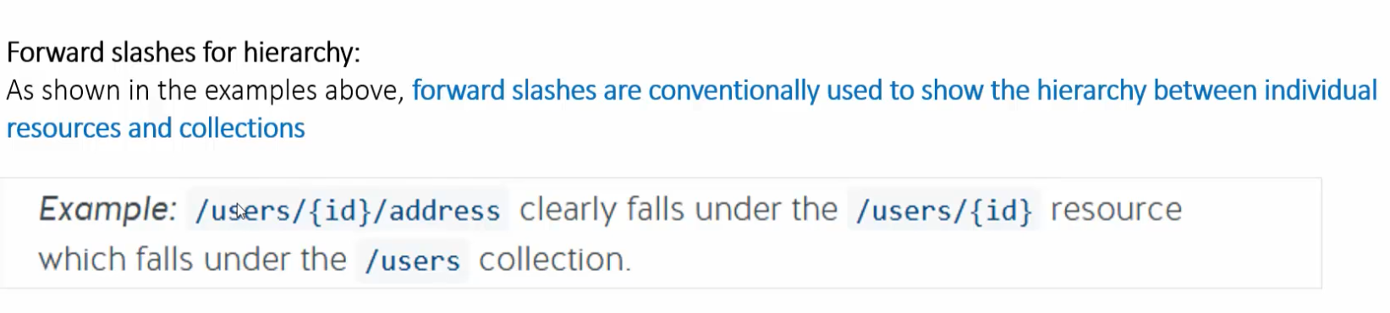

Slide 14
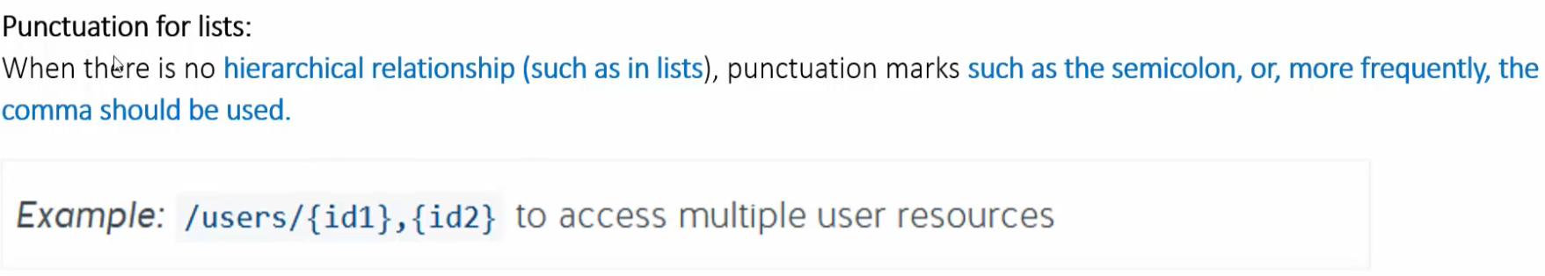
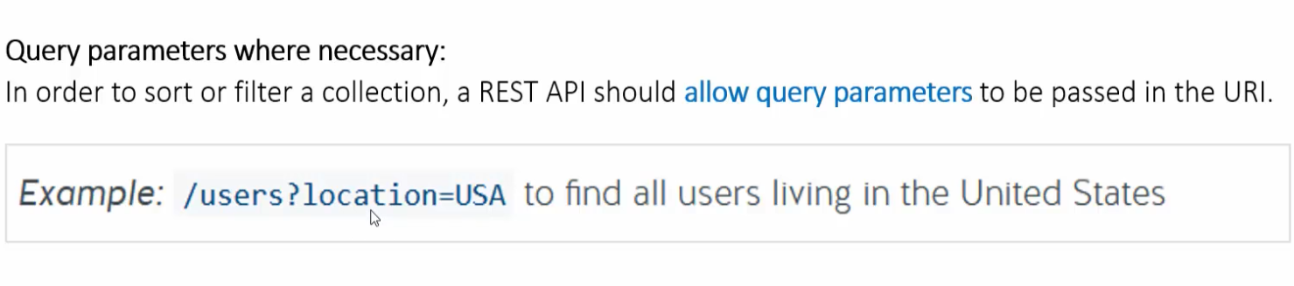
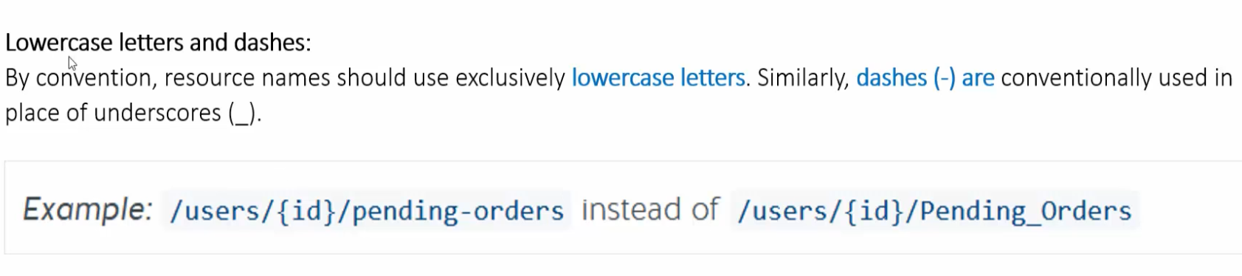

Slide 15
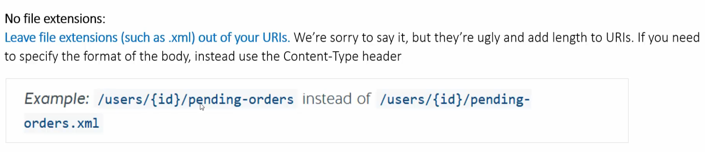
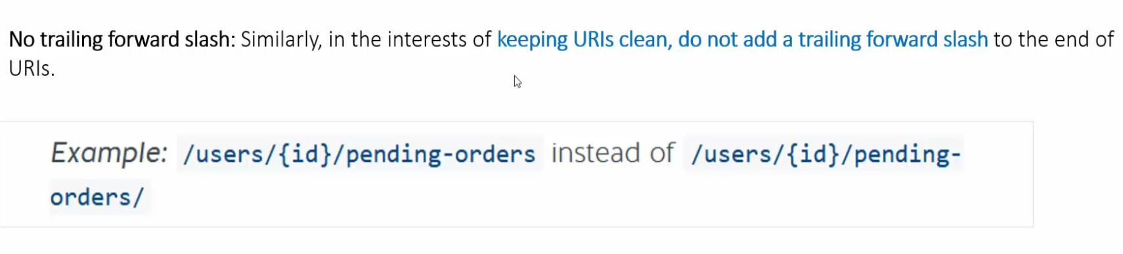

Slide 16
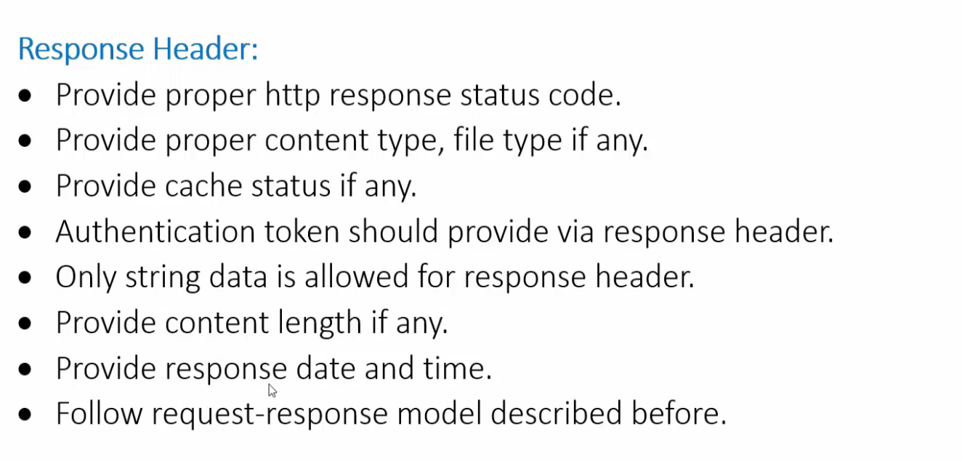
REST API Response Best Practice

Slide 17
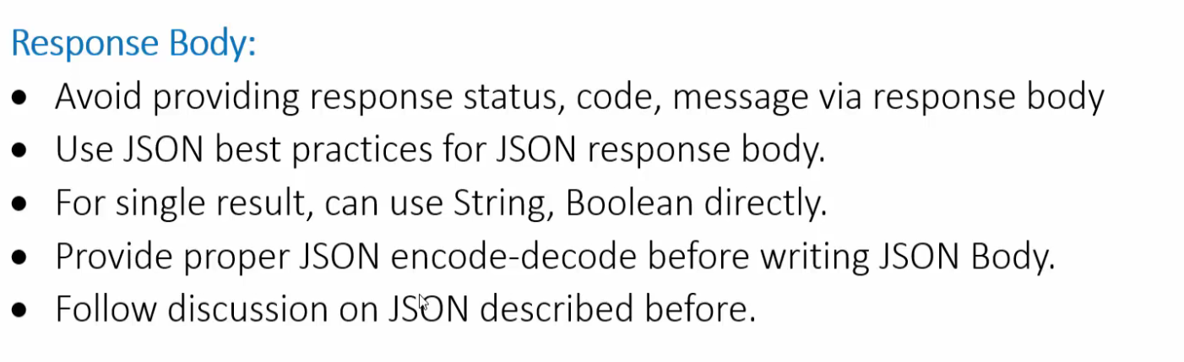
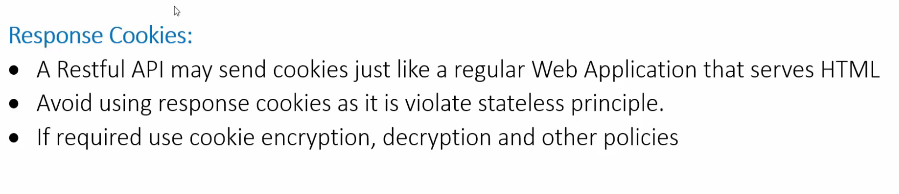

Slide 18

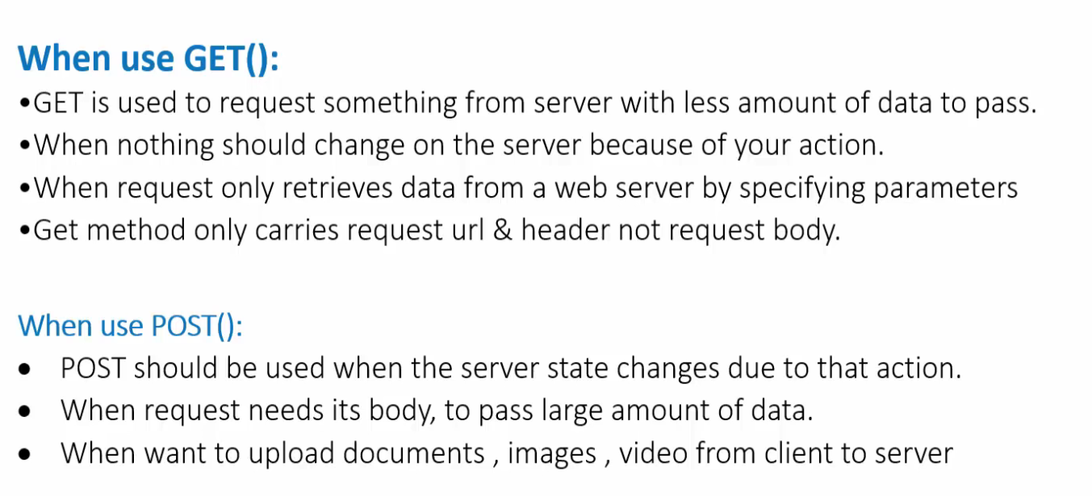

Slide 19
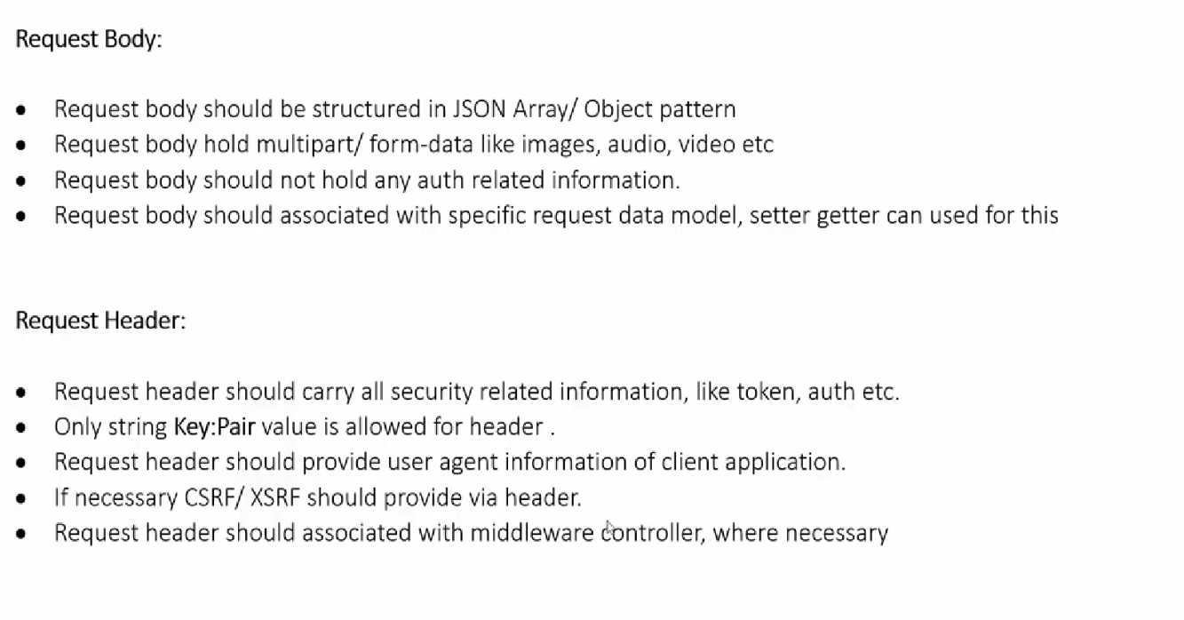

Slide 20

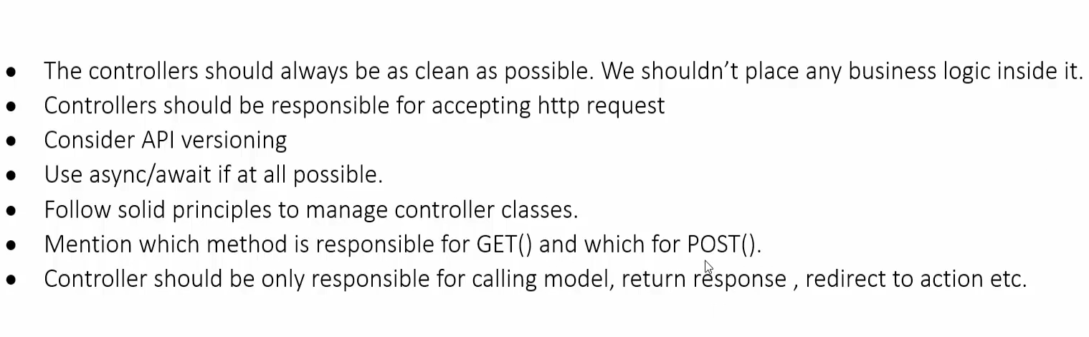

Slide 21
